Slide 1
Abusing WMI to build persistent, Asynchronous, and Fileless Backdoor
From Matt Graeber’s Presentation in Blackhat 2015
By Rajat Vij

Slide 2
What is WMI
Windows Management Instrumentation (WMI) consists of a set of extensions to the Windows Driver Model that provides an operating system interface through which instrumented components provide information and notification. WMI is Microsoft's implementation of the Web-Based Enterprise Management (WBEM) and Common Information Model (CIM) standards from the Distributed Management Task Force (DMTF).
WMI allows scripting languages (such as VBScript or Windows PowerShell) to manage Microsoft Windows personal computers and servers, both locally and remotely. WMI comes preinstalled in Windows 2000 and in newer Microsoft OSs. It is available as a download for Windows NT, Windows 95 and Windows 98.
Microsoft also provides a command-line interface to WMI called Windows Management Instrumentation Command-line (WMIC).
Notes:
Source : Wikipedia

Slide 3
Attackers are abusing WMI
First publically documented case in 2010 of malicious WMI in use.
Difficult to prevent and detect such attacks, can only use WMI against WMI attacks for mitigations and preventions.
WMI is used by sysadmins, and any tool useful to a sysadmin is useful to an attacker.
WMI is one means to execute your malware without dropping anything to the disk, although we can use powershell for the same by executing our malicious code in C in system memory.

Slide 4
Outline
Abridged History of WMI Malware
WMI Basics
WMI Architecture
WMI Interaction
Remote WMI
WMI Eventing
WMI Attacks
PoC WMI backdoor(by Matt Greaber)
Detection and Mitigation

Slide 5
WMI Malware History
2010-Stuxnet
Exploited MS10-061 – Windows Printer Spooler
Exploited an arbitrary file write vulnerability
WMI provided a generic means of turning a file write to SYSTEM code execution!
The attackers dropped a MOF file to gain SYSTEM-level execution.
2010-Ghost
Utilized permanent WMI event subscriptions to:
Monitor changes to “Recent” folder
Compressedanduploadedallnewdocuments
Activates an ActiveX control that uses IE as a C2 channel
2014-WMI Shell(Andrei Dumitrescu)
Uses WMI as a C2 channel
Clever use of WMI namespaces stage data exfil

Slide 6
WMI Basics
Powerful local & remote system management infrastructure.
Present since Win98 and NT4. Seriously.
Can be used to:
– Obtain system information
• Registry
• File system
• Etc.
– Execute commands
– Subscribe to events

Slide 7
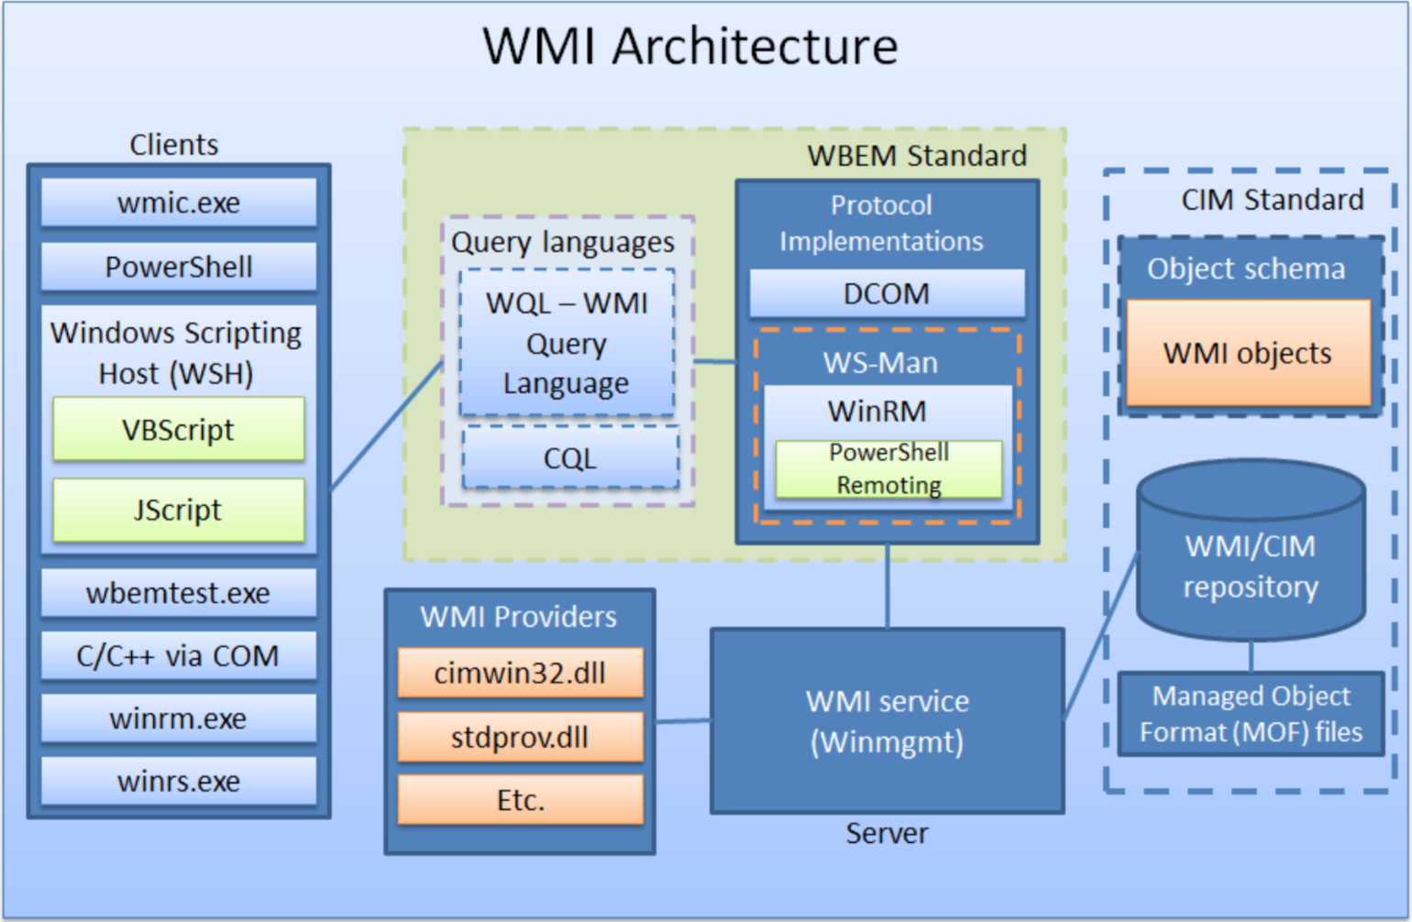

Slide 8
WMI Interaction
Utilities
Powershell
Wmi.exe
Sapien WMI Explorer
Wbemtest.exe
Winrm.exe
Linux Utilities: wmic, wmis, wmis-pth(pass-the-hash)
Windows Script Host Languages
VBScript
Jscript
IWbem* COM API
.NET System.Management classes

Slide 9
Remote WMI Protocols
DCOM
DCOM connections established on port 135
Subsequent data exchanged on port dictated by
– HKEY_LOCAL_MACHINE\Software\Microsoft\Rpc\Internet – Ports (REG_MULTI_SZ)
– configurable via DCOMCNFG.exe
Not firewall friendly
By default, the WMI service – Winmgmt is running and listening on port 135
WinRM/PowerShell Remoting
SOAP protocol based on the WSMan specification
Encrypted by default
Single management port – 5985 (HTTP) or 5986 (HTTPS)
The official remote management protocol in Windows 2012 R2+
SSH on steroids – Supports WMI and code execution, object serialization
Scriptable configuration via WSMan “drive” in PowerShell

Slide 10
WMI Eventing
WMI has the ability to trigger off nearly any conceivable event.
– Great for attackers and defenders
Three requirements
1. Filter – An action to trigger off of. Takes form of a WMI Query. 2. Consumer – An action to take upon triggering the filter. 3. Binding – Registers a Filter←→Consumer
Local events run for the lifetime of the host process.
Permanent WMI events are persistent and run as SYSTEM.
Type:
1. Intrinsic: Intrinsic events are system classes included in every namespace. Attacker/defender can make a creative use of these. Must be captured at a polling interval. Use carefully. Possible to miss event firings.
2. Extrinsic: Extrinsic events are non-system classes that fire immediately. No chance of missing these. Generally don’t include as much information.

Slide 11
WMI Attacks
From an attackers perspective, WMI can be used but is not limited to the following:
– Reconnaissance – VM/Sandbox Detection – Code execution and lateral movement – Persistence – Data storage – C2 communication
Benefits:
– Service enabled and remotely available on all Windows
– systems by default
– Runs as SYSTEM
– Relatively esoteric persistence mechanism
– Other than insertion into the WMI repository, nothing touches disk
– Defenders are generally unaware of WMI as an attack vector
– Uses an existing, non-suspicious protocol
– Nearly everything on the operating system is capable of triggering a WMI event

Slide 12
PoC WMI Backdoor
A pure WMI backdoor
PowerShell installer
PowerShell not required on victim
Intuitive syntax
Relies exclusively upon permanent WMI event subscriptions

Slide 13
WMI Attack Defence and Mitigation
Attacker Detection with WMI
Persistence is still the most common WMI-based attack
Use WMI to detect WMI persistence
Existing Detection Utilities:
- Sysinternals Autoruns
- Kansa
WMI is the free, agent-less host IDS that you never knew existed!
Mitigation
Stop the WMI service - Winmgmt?
Firewall rules
Existing Event logs – Microsoft-Windows-WinRM/Operational – Microsoft-Windows-WMI-Activity/Operational – Microsoft-Windows-DistributedCOM
Preventative permanent WMI event subscriptions

Slide 14
Questions?

